Slide 2
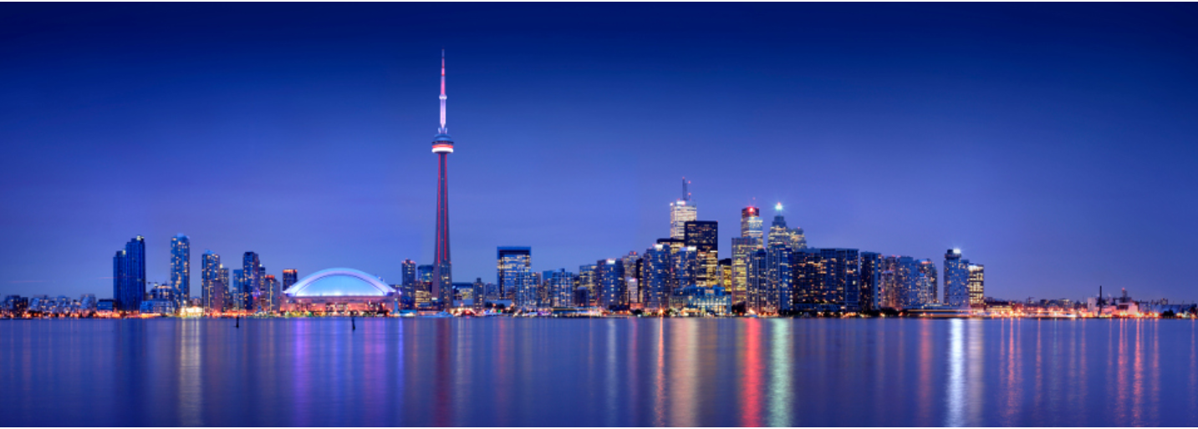
Unforgettable Trips start with Airbnb
Group 1 Zoe, Gemma, Manpree, Senthan, Shady, Steve

Slide 3

Agenda
Choose an Experience
Choose an Experience
Introduction
Data Preparation
Data Analysis
Conclusions
Choose an Experience
Choose an Experience

Slide 4
Why Airbnb?
Emerging Business
Interesting
Readily available data

Slide 5
Why Toronto?
Vibrant
Safety
Diversity
No 1 City in the Word
Landmarks
Nightlife options
Raptors!

Slide 6
Data Preparation

Slide 7
Data Analysis

Slide 8
Conclusion

Slide 9



Choose an Experience
QUESTIONS?
Adventure
Enthusiasm
Discovery

Slide 10
Choose an Experience
THANK YOU!
Adventure
Enthusiasm
Discovery

